Slide 1
HOW WE TAUGHT YEAR 7 MATHS
AT SANDRINGHAM COLLEGE IN 2022
Wendy Taylor
Wendy.taylor2@education.vic.gov.au
mathsquad.org/sc-7
Notes:
Open up word doc for curriculum overview, textbook and homework for topic 1.

Slide 2

In this talk I will...
Unpack the creation and implementation of our program
  How we decided on our curriculum
  The resources we used
    How they were created
    Their key features
    What worked / what didn’t (what will be refined)
  If time, overview of how I structure my lessons
Estelle Ashkar
This program was designed for our context with time allowance
(2 teachers, 100 periods each in 2021)
This talk is designed to give food for thought and many resources that you can dip in and out of and modify.

Slide 3
Curriculum Overview
Semester | Topic | Duration | Summative Assessment
1 | Integers and Algebra | 6 weeks | Test
 | Decimals | 7 weeks | Test
 | Measurement | 3 weeks | Project
2 | Number Properties | 7 weeks | Test
 | Fractions | 8 weeks | Test
 | Statistics | 4 weeks | Project
Many students begin high school without strong multiplicative knowledge. We wanted to use Semester 1 to build their knowledge through warm ups so they could be more successful in Semester 2.
We wanted them to start high school learning something *new* and also for them to learn integers and algebra early so we could revisit it throughout the year.
We wanted generous time lines so people didn’t feel the need to rush and had time to revisit previously taught skills
We wanted less topics so we could assess thoroughly, though less regularly.
We liked the idea of students doing a project at the end of each semester too.

Slide 4
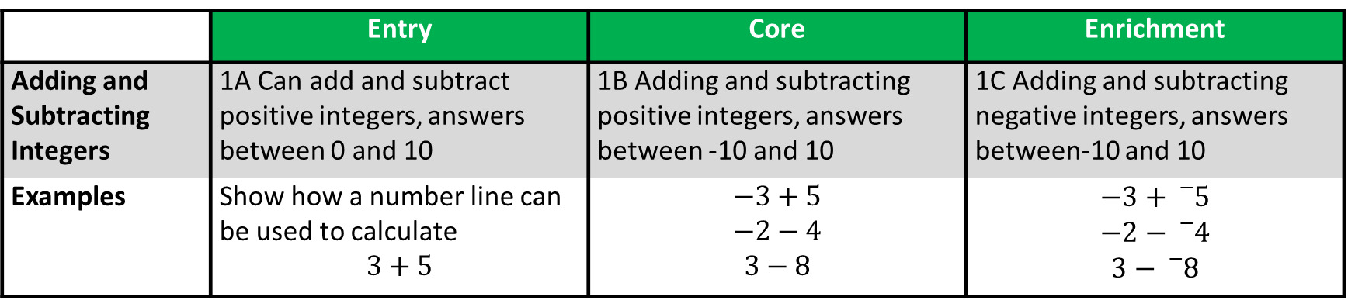
Differentiation
 | Entry | Core | Enrichment
Adding and Subtracting Integers | 1A Can add and subtract positive integers, answers between 0 and 10 | 1B Adding and subtracting positive integers, answers between -10 and 10 | 1C Adding and subtracting negative integers, answers between-10 and 10
Examples | Show how a number line can be used to calculate $$3+5$$ | $$−3+5$$ $$−2−4$$ $$3−8$$ | $$−3+{}_{}^{−}5$$ $$−2−{}_{}^{−}4$$ $$3−{}_{}^{−}8$$
Every skill is broken into three levels:
  Core is the “expected standard” for Year 7, with a Further Maths Pathway in mind.
  Entry is aimed at preparing students for Core.
  Enrichment is stretching students and designed with a Maths Methods Pathway in mind.
Whole class teaching (generally) focuses on the Core skill, and students (generally) choose the level they work at.
**Tip: including examples for each curriculum dot point is golden for increasing consistency**

Slide 5
Resources - Textbook
Resource | How | Why
Student Textbook | Microsoft word + school’s instructional model (tablet required for hand written examples) | Specific curriculum needed a specific resource and…
Commercial Textbook | Our Textbook
So many topics, so many skills | Covers our curriculum exactly
Exercises often have multiple examples and multiple skills | One specific skill at a time
Skills can get very hard very quickly | Generally 20 questions for each basic skill
Problem solving and reasoning part of an exercise (at the end when students are often working independently at home!) | We created “Application Lessons” to allow for increased collaboration and support
 | We could align it to our school’s instructional model
 | We could modify as we went
Our School’s Instructional Model
S – Set the goal
A – Activate prior knowledge
E – Explicit teaching
P – Practice
A – Assessment for Learning
R – Reflection and Recognition

Slide 6
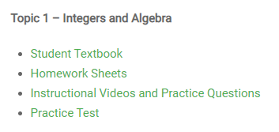
Resources - Textbook
Webpage: mathsquad.org/sc-7
Textbook Features
Learning Intention and Success Criteria for each skill
Definitions of key words
Quick “Activate Prior Knowledge” question
Explicit teaching
  Very brief board notes
  Worked examples written by hand, accompanied by “what we think”
  “Your turn” questions for students to do that gives them and the teacher an indication if they are ready for independent practice and at what level.
  Routine questions. Approx. 20 questions so students have sufficient opportunities to practice the specific skill
    Routine questions have hyperlinked text to “First 5 Live” videos
  Stretch questions. Approx. 5 additional questions that give students the chance to apply their knowledge in more complex ways (often interleaving previously taught skills)
  Blue text to show students what needs to be written in their books
  Hyperlinked solutions
  Application Lessons for almost every set of skills (Entry, Core, Enrichment = 1 set)
  Early finisher activities
Let’s take a look…

Slide 7
Resources - Textbook
Resources Used
Don Steward’s site Median
Nrich (by University of Cambridge)
Jo Morgan’s site Resourcaholic
Past AMC papers (free download of past 4 years on the AMT site)
Past NAPLAN Papers (free downloads of past 5 years on the ACARA site)
Cambridge textbooks

Slide 8
Resources - Homework
Resource | How | Why
Homework Booklets | Latex programming (small edits can be made using Adobe Acrobat Pro) | Increase retention of skills learnt previously + give an achievable homework task for all students
Notes:
1 homework sheet per week
Completed at home and corrected in class
Hyperlink provided so students (and parents) know where to head for support
Sample page included to show students what success looks like
Aligned exactly with the differentiated curriculum
Expectation: “Complete what you can each week with your best effort and watch your skills grow over time”
SEAL Class – 10x AMC questions per week
Webpage: mathsquad.org/sc-7
Let’s take a look…
Topic 1 = Times tables + Primary School Skill Review + Topic 1 Skills + Worded Qns
Topic 2 = Times tables + Topic 1 Review + Topic 2 Skills + Worded Qns
Topic 5 = Alternating between Topic 1, Topic 2 and Topic 4 Review + Topic 5 Skills + Worded Qns.

Slide 9
Resources - Instructional Videos
Resource | How | Why
Instructional Videos | Created on a Microsoft Surface using Camtasia for Recording and Editing | To give students support when working independently on textbook qns or homework
Notes:
Completed using OneNote to model exactly how students can set out their work
Very time consuming to create…
Webpage: mathsquad.org/sc-7

Slide 10
Resources - Practice Tests
Resource | How | Why
Practice Tests | Microsoft Word | So our assessment aligned with our curriculum
Notes:
Mainstream tests assessed entire curriculum (Entry, Core, Enrichment)
“Enhanced” tests (for SEAL and other high achieving students) assessed Extension too
  extension skills were taken from the Stretch Questions
Problem Solving and Reasoning at the end
Problem Solving was based on the Application Lessons
Reasoning wasn’t explicitly done in class much at all this year (whoops!), updated textbook (online) has Reasoning Questions with all Application Lessons
Webpage: mathsquad.org/sc-7
Let’s take a look…

Slide 11
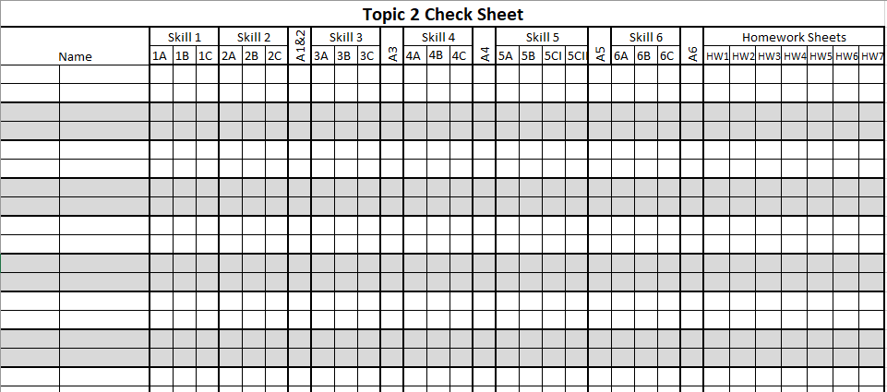
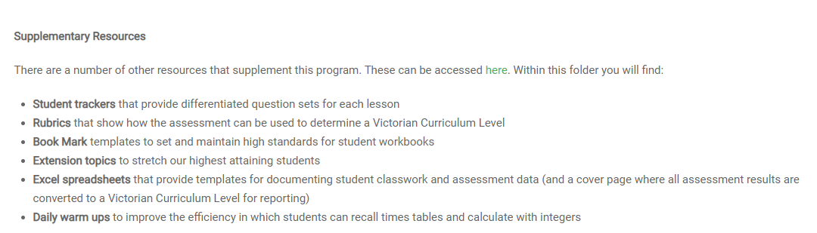
Resources - Miscellaneous
Webpage: mathsquad.org/sc-7

Slide 12
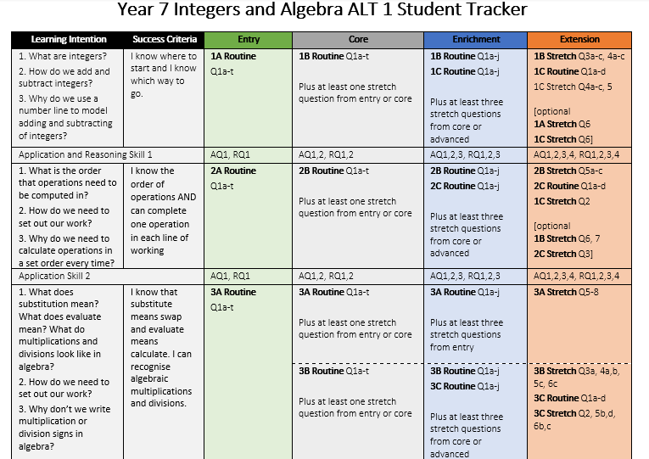
Student Trackers
This was a guide.
Teachers could modify beforehand or on the spot.
Roughly, one double period was spent per row (including explicit teaching and other activities), though teachers could pace based on students needs

Slide 13
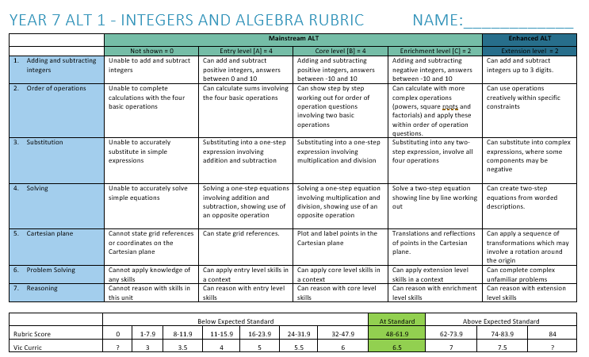
Rubrics

Slide 14
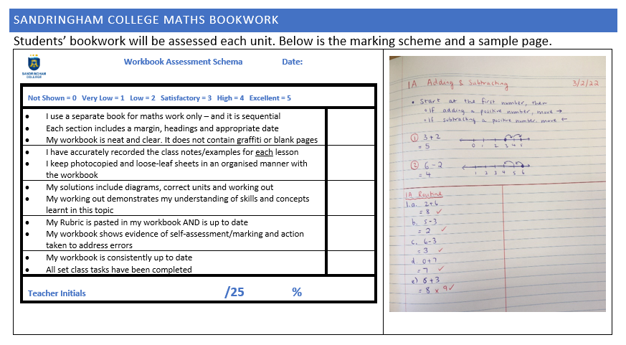
Book Mark

Slide 15
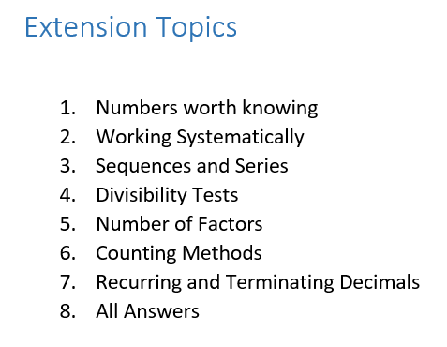
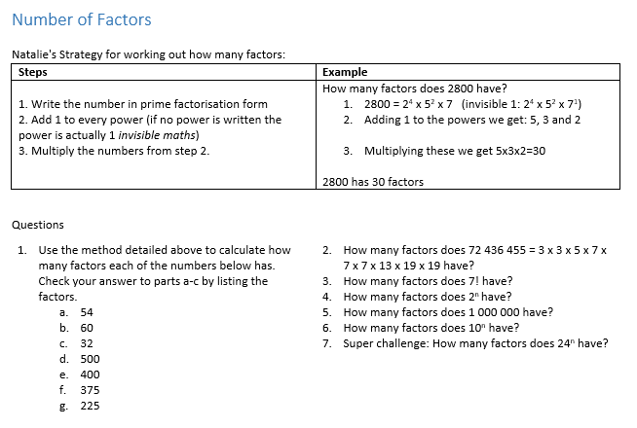
Extension Topic

Slide 16
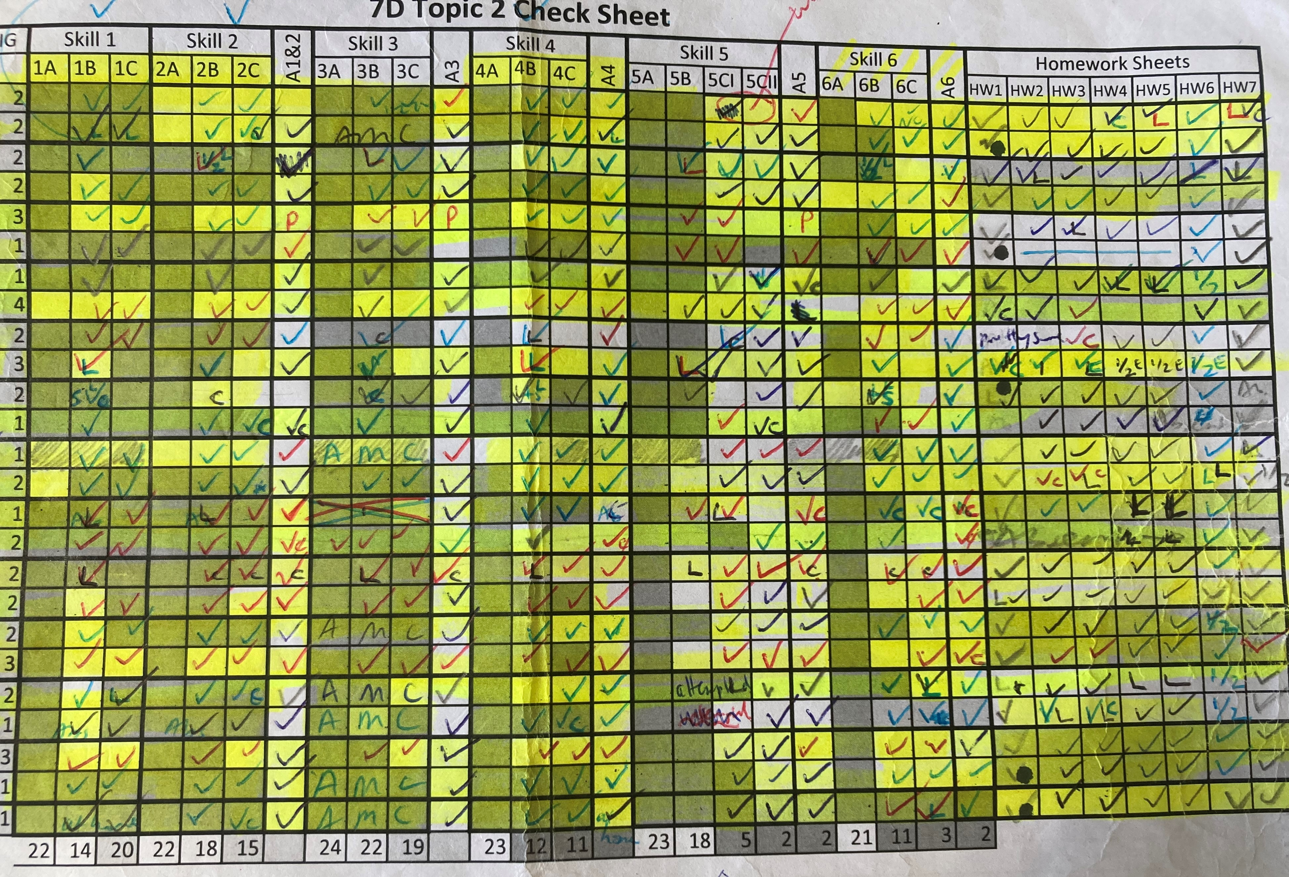
Excel Spreadsheets

Slide 17
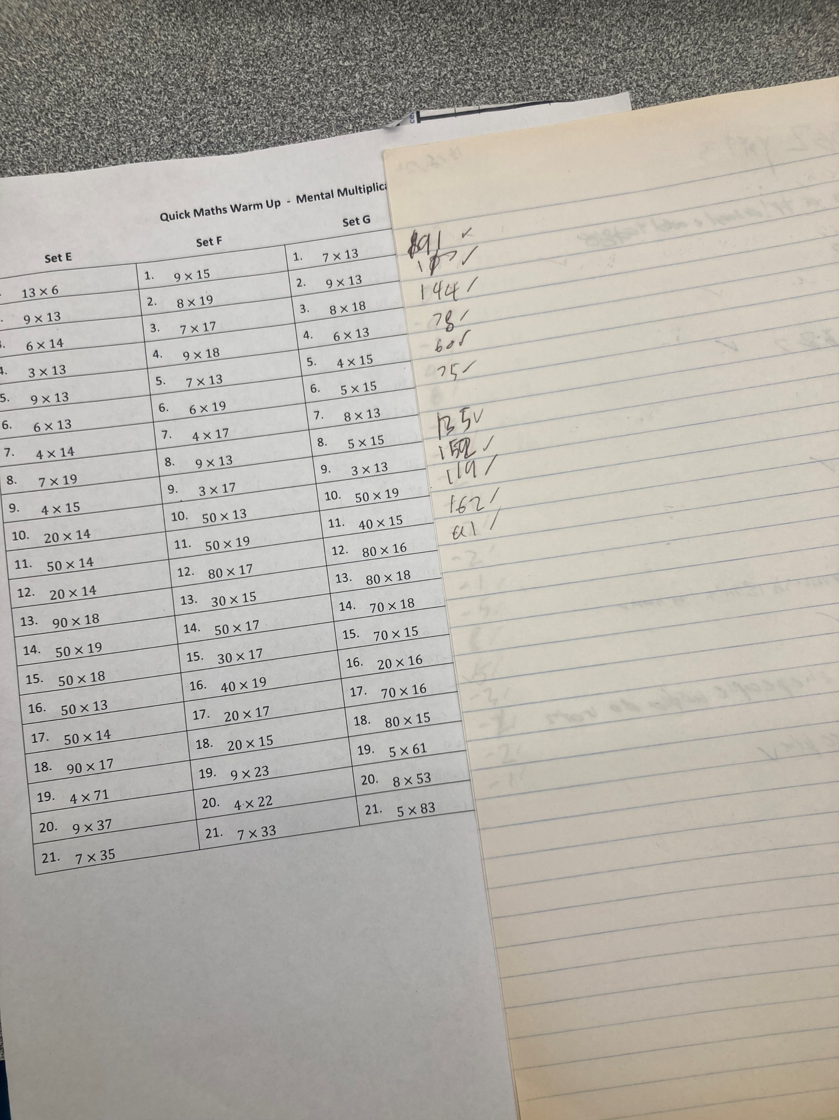
Daily Warm Ups

Slide 18
Questions? Mathsquad.org/sc-7
https://www.surveymonkey.com/r/MAV22Thurs

Slide 19
My Lesson Structure
Routines are GOLDEN!!!
Quick Maths Warm Up for 1 minute, display knowledge on growth graph (I mark the roll)
Activate Prior Knowledge activity (generally using mini whiteboards)
Board notes
  Completed in silence
  I write out the notes + the questions (not answers) for the worked examples
  Once one student is finished we give 20 seconds for people to finish their current sentence.
I talk through the worked examples, referring to the notes and calling on non-volunteers at key moments
Students then do “their jobs”
  Complete the Your Turn Question (on their mini white board)
  Finish the notes, copying at least one worked example (while students finish their notes I check their “Your Turn” questions)
  Start independent practice (correcting as they go)
  Generally, ample time is given and students can complete early finishers activities (though now can do “Collaborative Task”), though occasionally some work is required to be done as part of homework.

